Slide 1

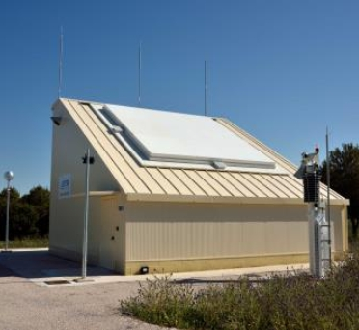


DETECCIÓN DE MANIOBRAS
EN ÓRBITA BAJA TERRESTRE
CON DATOS DE RADAR
US: Jose M. Montilla, Julio C. Sanchez, Rafael Vazquez, Jorge Galan-Vioque
Indra: Javier Rey Benayas
ESA: Jan Siminski
IV Congreso de Ingeniería Espacial
20-24 Junio 2022

Slide 4
Motivation and Introduction 1
Manoeuvre Detection Metrics 2
Results 3
Conclusion & Future work 4

Slide 5
Motivation and Introduction
1

Slide 6
Motivation.
  In Space Surveillance and Tracking (SST), accurate orbital determination and manoeuvre detection crucial to infer objects’ orbital information and future behaviour.
  Essential to carry out tasks such as:
    prediction of potential conjunctions with operating satellites
    making avoidance orbital corrections
    predicting re-entries
    identifying fragmentations
    updating orbital elements of known satellite
    … among others

Slide 7
Motivation.
Satellites performing unknown manoeuvres pose a challenge when trying to associate the new collected observations (laser/radar/optical) with the catalogued reference orbits
Manoeuvre detection can significantly reduce the number of uncorrelated targets detected by the SST sensors infrastructure
A considerable number of uncorrelated objects are just known satellites, that have performed unpublished manoeuvres

Slide 8
Introduction.
This work presents two metrics for the detection of manoeuvres in Low Earth Orbit (LEO) from radar data.
The metrics were initially introduced in “Vazquez el al., Manoeuvre detection for near-orbiting objects. In 8th European Conference on Space Debris, (2021),” and validated with simulations.
Here, additional validation is provided with real tracks from S3TSR, the Spanish surveillance radar developed, installed and validated by Indra with the funding of CDTI under the technical and contractual management of ESA.
Manoeuvre information and ephemerides are obtained from ESA/ESOC and DLR/GSOC to assess the results, for a number of selected scenarios.

Slide 9
Introduction.
  Goal: use of S3TSR data to detect possible manoeuvres of known objects in Low Earth Orbits.
  Inputs: for a given satellite and time interval, S3TSR data, precise orbits (only used as a starting point and to characterize a sufficiently precise propagator), manoeuvre data (for testing purposes only).
  Output: probability of manoeuvre for each metric

Slide 10
Introduction.
Development carried out on OREKIT & MATLAB
  OREKIT: Written in JAVA, can be interfaced (with some difficulty) with MATLAB
  MATLAB: Great for data analysis and plotting
OREKIT provides:
  Handling of all required frames at all dates
  Absolute propagators in cartesian coordinates, modified equinoctial elements or Keplerian classical elements using variable-step numerical methods
  Perturbations, including non-spherical harmonics of arbitrary order, drag and atmospheric models, solar radiation pressure and third-body effects
  A Taylor differential algebra framework
  Handling of common orbital formats such as TLEs and OEMs

Slide 11
Manoeuvre Detection Metrics
2

Slide 12
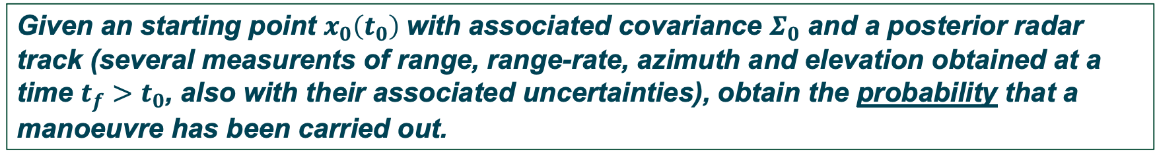
Manouevre Detection Metrics
The problem can be mathematically formulated as follows:
To address this problem:
  Use of attributables to “compress” radar measurements
  Keep only range and range-rate attributable
  Metric 1: Mahalanobis distance metric
  Metric 2: Control distance metric (ΔV)
Given an starting point $x_{0}\left(t_{0}\right)$with associated covariance $Σ_{0}$ and a posterior radar track (several measurents of range, range-rate, azimuth and elevation obtained at a time $t_{f}>t_{0}$, also with their associated uncertainties), obtain the probability that a manoeuvre has been carried out.

Slide 13
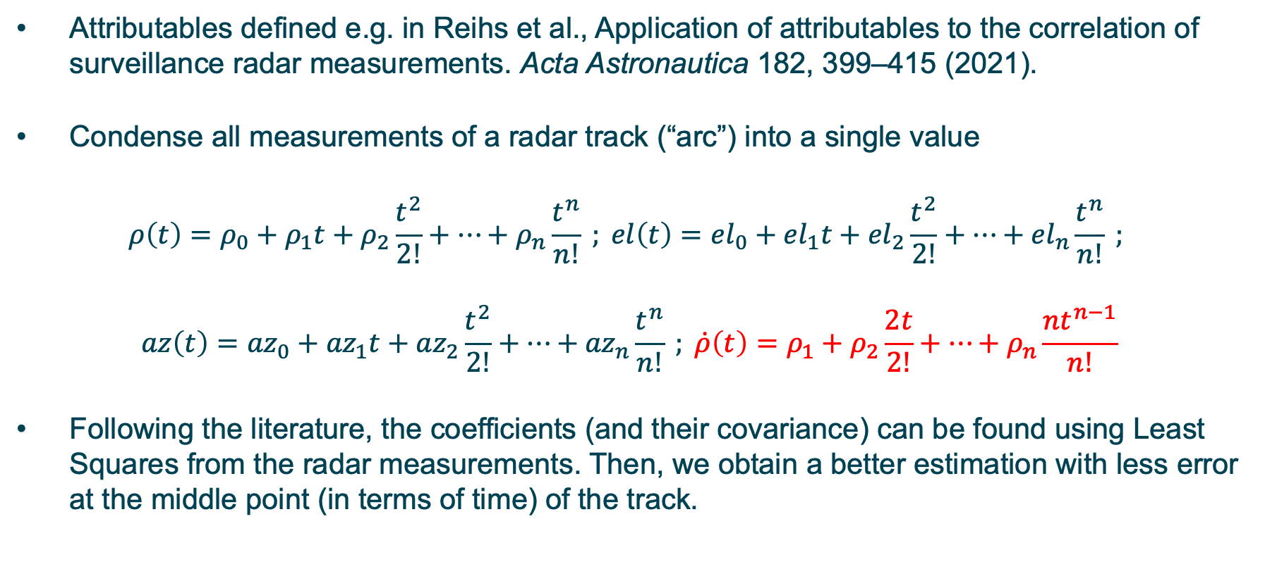
Attributables
Attributables defined e.g. in Reihs et al., Application of attributables to the correlation of surveillance radar measurements. Acta Astronautica 182, 399–415 (2021).
Condense all measurements of a radar track (“arc”) into a single value
$$ρ\left(t\right)=ρ_{0}+ρ_{1}t+ρ_{2}\frac{t^{2}}{2!}+⋯+ρ_{n}\frac{t^{n}}{n!} ; el\left(t\right)={el}_{0}+{el}_{1}t+{el}_{2}\frac{t^{2}}{2!}+⋯+{el}_{n}\frac{t^{n}}{n!} ;$$
$$az\left(t\right)={az}_{0}+{az}_{1}t+{az}_{2}\frac{t^{2}}{2!}+⋯+{az}_{n}\frac{t^{n}}{n!} ; \dot{ρ}\left(t\right)=ρ_{1}+ρ_{2}\frac{2t}{2!}+⋯+ρ_{n}\frac{nt^{n−1}}{n!}$$
Following the literature, the coefficients (and their covariance) can be found using Least Squares from the radar measurements. Then, we obtain a better estimation with less error at the middle point (in terms of time) of the track.

Slide 14
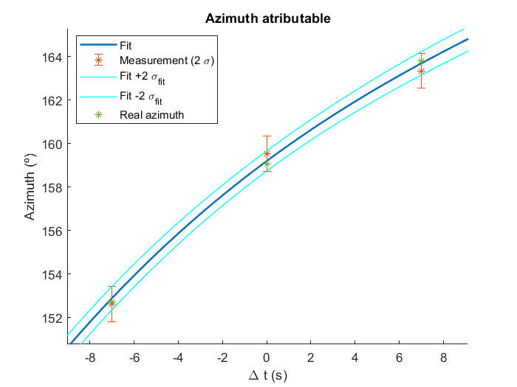
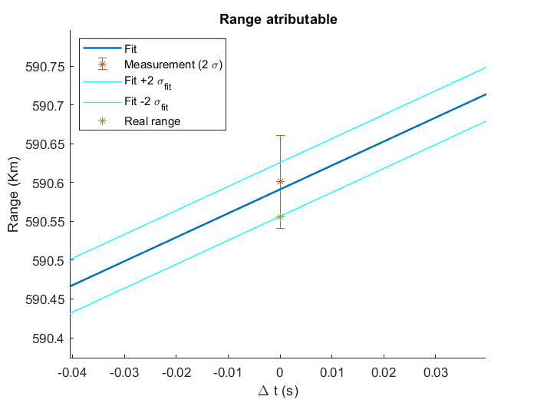
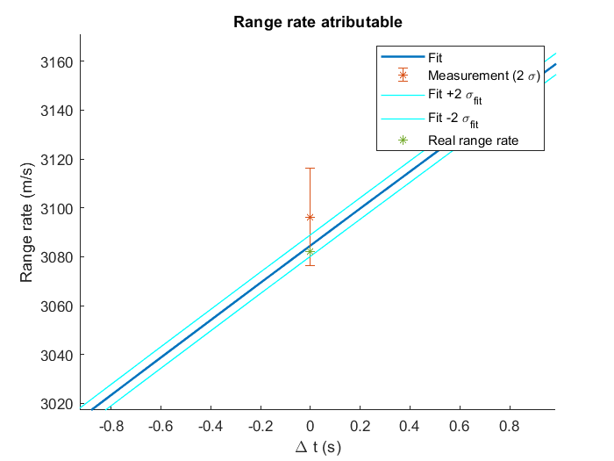
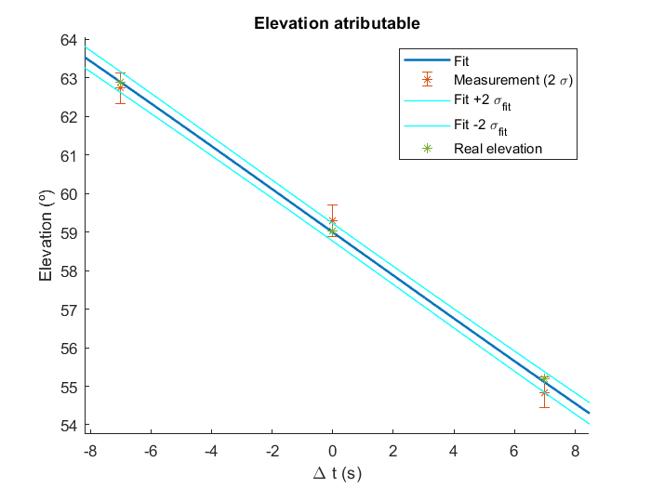
Attributables
Attributables example and reduction of error.

Slide 15
Mahalanobis distance metric
Metric 1: Use of Mahalanobis distance to compare real and projected attributable
  Sample the initial condition of the PDF
  Propagate the sampled points using an OREKIT propagator up to attributable time with Taylor differential algebra methods
  Projected values at attributable time are obtained as a cloud of points.
  Now for each sampled orbit, one can compute the range and range-rate measurements at the attributable time, obtaining a “cloud of measurements”, and from it mean and covariance.
  Finally, the attributables and the mean of projected measurements can be compared. If no manoeuvre has been performed, one would expect that both values should more or less agree, thus their difference should be close to zero, and we know an estimation of its covariance.
  We can then obtain the Mahalanobis distance which will be a metric for manoeuvre detection.

Slide 16
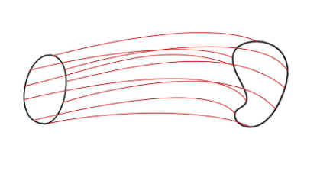
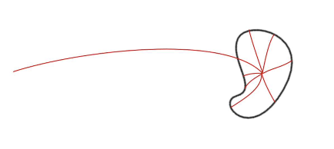
Taylor differential algebra
Taylor differential algebra to propagate uncertainty as opposed to Monte-Carlo simulations
VS.
Also more precise than basic linear covariance analysis.
See e.g. Andrea, A. and Maisonobe, L. Automatic differentiation for propagation of orbit uncertainties on orekit. In Stardust Conference, (2016).

Slide 17
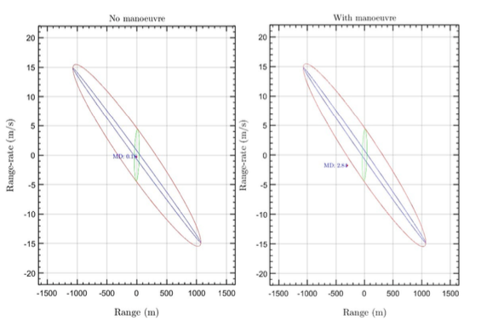
Mahalanobis distance metric
Use of Mahalonobis distance(MD)/confidence interval example: no manoeuvre (top) vs. manoeuvre (bottom). Green: measurement uncertainty; blue: orbit uncertainty; red: combination of both.

Slide 18

Probability Metric 1 (based on MD)
Metric 1: Based on the MD, a probability measure has been computed based on the fact that the square of MD is distributed as chi-square:
$$P_{MD}=\max{\{0,{2(χ}^{2}\left(MD^{2};2\right)−0.5)\}}$$
Thus, we are taking a 50% confidence region; if one is inside it, the probability is assumed as 0%. Otherwise, the probability scales with the distance from that threshold.

Slide 19
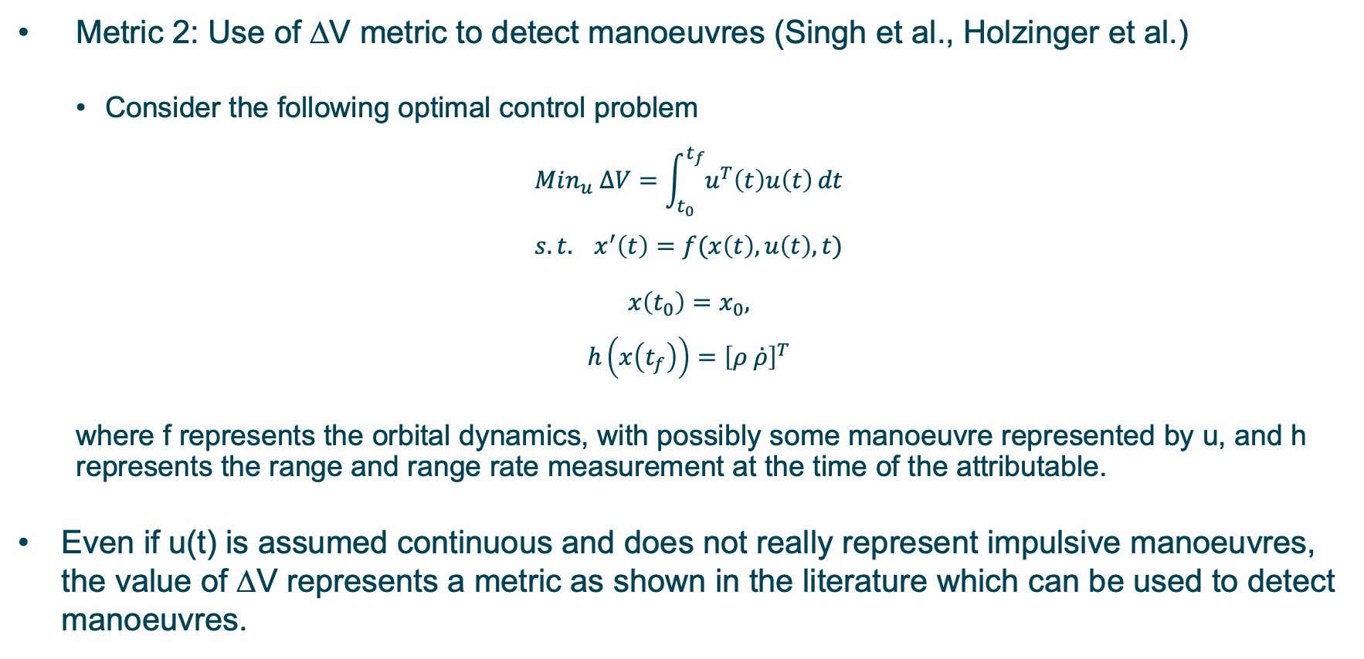
Control Distance metric
Metric 2: Use of ΔV metric to detect manoeuvres (Singh et al., Holzinger et al.)
  Consider the following optimal control problem
$$Min_{u} ΔV=\int_{t_{0}}^{t_{f}}{u^{T}\left(t\right)u\left(t\right)}dt$$
$$s.t. x^{′}\left(t\right)=f(x\left(t\right),u\left(t\right),t)$$
$$x\left(t_{0}\right)=x_{0},$$
$$h\left(x\left(t_{f}\right)\right)={\left[ρ \dot{ρ}\right]}^{T}$$
  where f represents the orbital dynamics, with possibly some manoeuvre represented by u, and h represents the range and range rate measurement at the time of the attributable.
Even if u(t) is assumed continuous and does not really represent impulsive manoeuvres, the value of ΔV represents a metric as shown in the literature which can be used to detect manoeuvres.

Slide 20
Control Distance metric
Software package “casadi” (Matlab, interface to the well-known IPOPT solver) used to find the solution to the deterministic problem. Uncertainty added by solving it a number of times (Monte Carlo-style simulation), thus one obtains a distribution of ΔV represented as a CDF.
Example of CDF with/without manoeuvre:

Slide 21
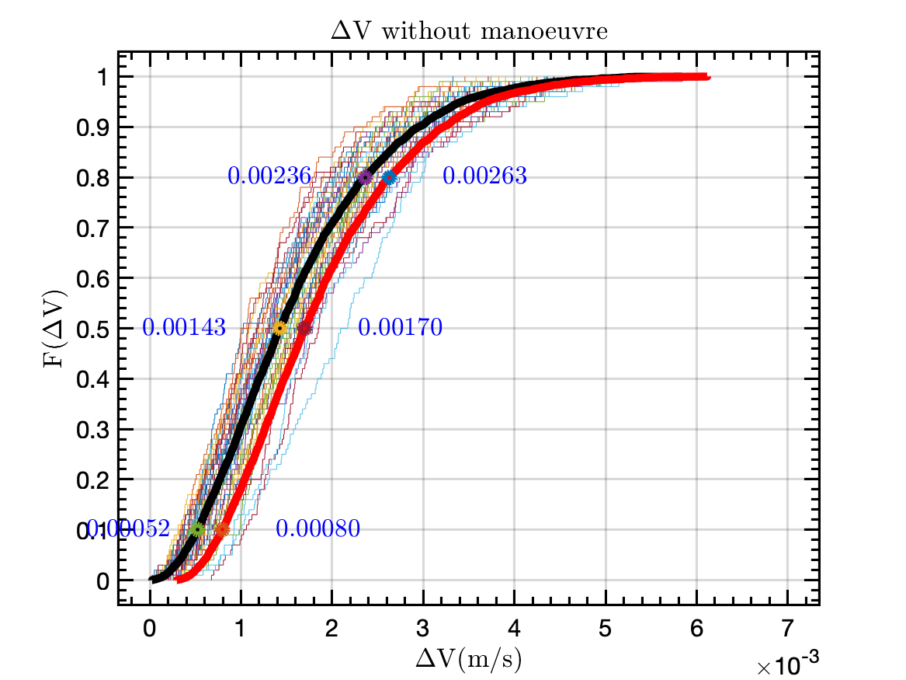
Probability Metric 2 (based on ΔV)
Metric 2: First compute a baseline for each scenario doing a Monte Carlo analysis without manoeuvre. Percentiles 0.1,0.5,0.8 computed for both the mean distribution (M) and the mean + 2 sigma (D) distributions.

Slide 22
Probability Metric 2 (based on ΔV)
Algorithm 2: Six metrics were considered:
  For P1M (and P1D), compute the probability of ΔV being below the percentile 0,1 of mean (respectively, 2-sigma) non-manoeuvred distribution. Then P1=max{0,10(0.1-p)}. If p is more than 0.1 the probability becomes zero and if it is below 0.1, the difference is multiplied by 10 (thus having zero probability would represent a 100% probability of manoeuvre).
  P5M and P5D are computed similarly for the 0.5 percentile.
  P8M and P8D are computed similarly for the 0.8 percentile.
In simulations it was found that P1M and P1D perform best.

Slide 23
Probability Metric 2 (based on ΔV)
Example P1D:
->Non-Manoeuvre mean+2-sigma 10-percentile is 0.0080
Now look at distribution we want to compare and look at p(ΔV <=0.0080)
  If p>=0.1 -> P1D=0
  If p<0.1: P1D=10*(0.1-p)

Slide 24
Results
3

Slide 25
Scenarios
A total of 15 scenarios were selected, using real radar data obtained from S3TSR, and manoeuvre information and precise ephemerides are obtained from ESA/ESOC and DLR/GSOC.
The satellites under consideration were Sentinel-1A, Sentinel-1B, Sentinel-2A, Sentinel-2B, Swarm-C, TerraSAR-X and TanDEM-X.
In total, 158 segments (which were defined as the interval after one radar track up to the next and lasted from 12 hours to more than 48 hours in some cases) were considered, 24 of them with manoeuvres and 134 without manoeuvres, to assess not only the capability of the metrics to detect manoeuvres but also to avoid false positives.

Slide 26
Scenarios
From the precise ephemerides, an OREKIT propagator was developed to best fit the ephemerides by taking into account gravity harmonics (up to order 40), third-body perturbations (Sun and Moon), solar radiation pressure and drag.
If the probability metric is equal or higher than 0.5 a manoeuvre is considered to have been performed.

Slide 27
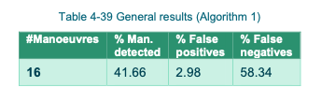
Results: Metric 1 (Mahalanobis distance)
Analysing the results, the causes of errors are as follows:
From a total of 5 false positives, all except one present less than 10 plots in the track following the manoeuvre. Thus, the main cause of false positives is tracks with fewer plots.
From a total of 14 false negatives, all except one were segments of length equal to or larger than one day. Thus, the main cause of false negatives is longer propagations accumulating additional propagation error. Sometimes these longer propagation periods are due to missed radar observations right after the manoeuvre.

Slide 28
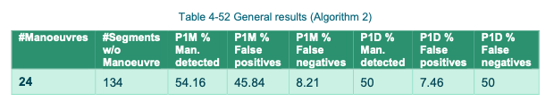
Results: Metric 2 (ΔV)
Better results than metric 1 but the price to pay is more false positives.
Very similar conclusions as metric 1 with regards to causes of error.

Slide 29
Conclusions & Future Work
4

Slide 30
Conclusions
Two probability metrics for manoeuvre detection have been developed and tested with real data.
The obtained results were very good in simulation, but the real data results are in need of improvement. The main identified difficulty was the scarcity of measurements (low number of tracks and/or low number of plots). Future expansion of the capabilities of S3TSR may improve the quality of the metrics, as well as considering other sources of data (laser).
From an innovation point of view, the results are very interesting, since most of the results in the literature depend on having numerous measurements, which was not the case here!

Slide 31
Future work
Extensions on the algorithms: other distances (e.g. Bhattacharyya distance), directly addressing the stochastic optimal control problem of metric 2…
Manoeuvre detection filter: not presented here, but also developed, combines orbit determination and manoeuvre detection (if a manoeuvre has been detected, is taken into account by covariance inflation in the filter).
The aim is to have these metrics integrated in the S3T Cataloguing System in order to provide routine automatic manoeuvre detection capabilities to S3TSR, driven by CDTI funding and ESA management.

Slide 32
Thanks!
Questions?
Acknowledgement: the authors thank the Centro de Desarrollo Tecnológico e Industrial (CDTI) for providing S3TSR data and funding this project.

